Slide 1
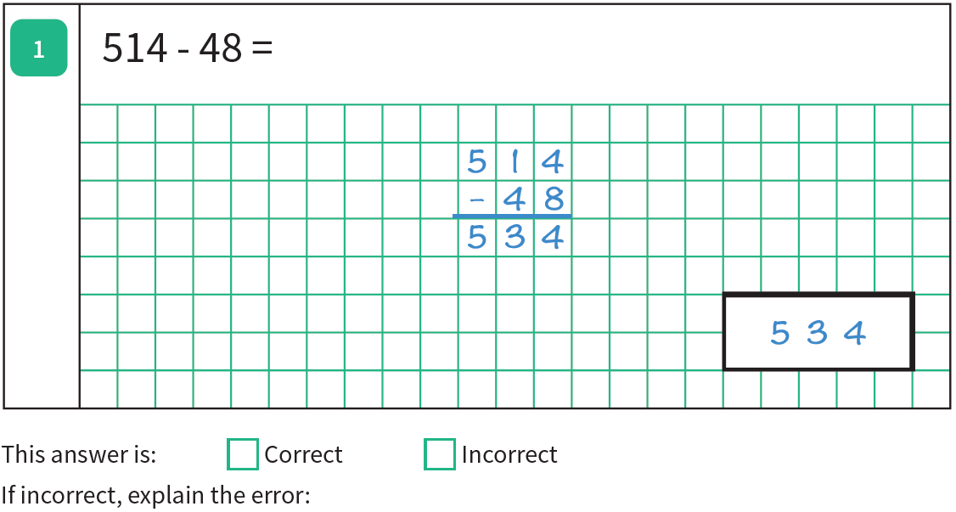
Go through the work and check the answers. Help us to understand the errors by explaining where we have gone wrong or how to find the correct answer. Explain and show the correct answer.

Slide 2
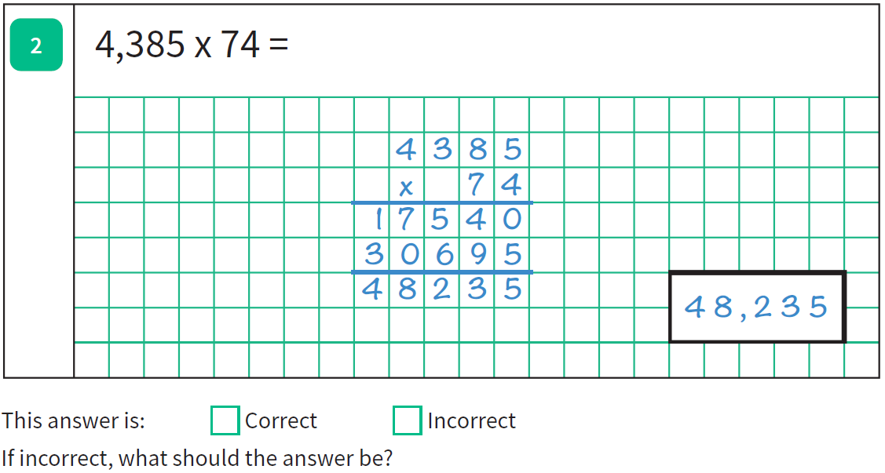

Slide 5
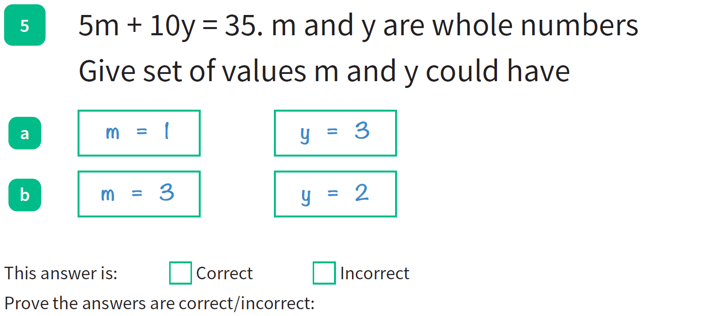

Slide 6
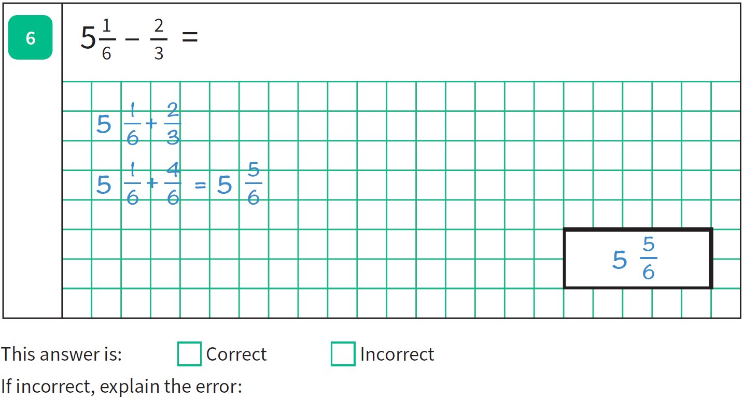

Slide 8
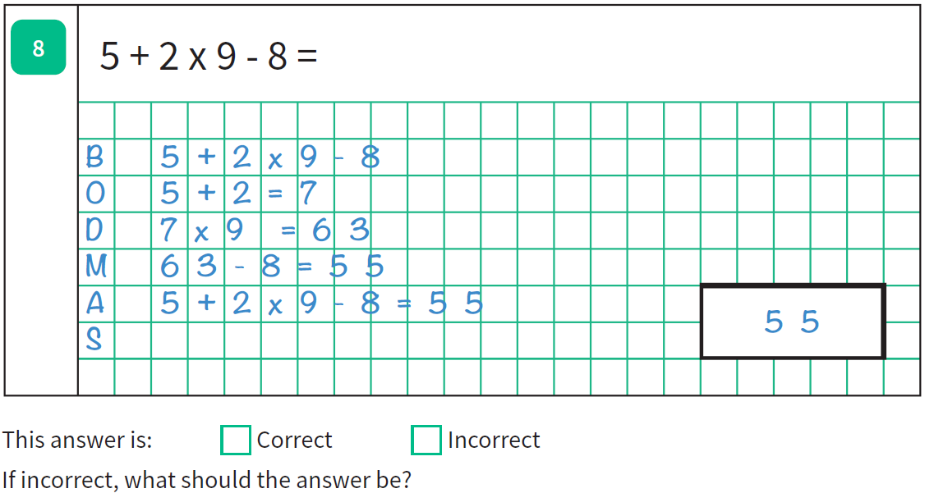

Slide 10
