Slide 1

2020 Virtual Summer
Olympics
Working together, stronger together

Slide 2

Keys Meadow will be competing in this year’s Virtual Summer Olympics representing Turkey. We will be competing against children from other schools in Enfield.

Slide 3
The Five Olympic Educational Themes
Joy of effort
Young people develop and practise physical, behavioural and intellectual skills by challenging themselves and each other in physical activities, movement, games and sport.
Fair play
Fair play is a sports concept, but it is applied worldwide today in many different ways. Learning to play fair in sport can lead to the development and reinforcement of fair play behaviour in one’s community and in one’s life.
Practising respect
When young people who live in a multicultural world learn to accept and respect diversity and practise peaceful personal behaviour, they promote peace and international understanding.
Pursuit of excellence
A focus on excellence can help young people to make positive, healthy choices, and strive to become the best that they can be in whatever they do.
Balance between body, will and mind
Learning takes place in the whole body, not just in the mind, and physical literacy and learning through movement contributes to the development of both moral and intellectual learning. This concept was the cornerstone of Pierre de Coubertin’s interest in reviving the Olympic Games.
(Pierre de Coubertin was the founder of the International Olympic Committee)

Slide 4
What you need to do:
Choose 2 activities from the active section

Slide 5
Choose 1 activity from the educational section

Slide 6
Choose 1 activity from the creative section
And finally, choose your last activity from any of the 3 sections. In total you should have 5 activities.

Slide 7
Olympic Quiz questions if you have chosen to do this activity
EYFS/ KS1
https://forms.office.com/Pages/ResponsePage.aspx?id=vy69695Ov0GXTc5sfIB8Ik8lgYJ5_KVAtL7RavH5H_JUOVVXSU1aSE0yQlNLODNFMDVMWlRGMVozTS4u
KS2
https://forms.office.com/Pages/ResponsePage.aspx?id=vy69695Ov0GXTc5sfIB8Ik8lgYJ5_KVAtL7RavH5H_JUODFJMFNISzU1MEVaUVZaVEpWMjlVVERWTy4u

Slide 8
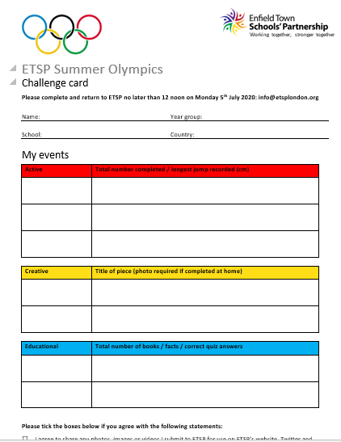
Final Information
Once you have chosen your activities, complete your challenge card.
You have until Friday 3rd July to complete all of your activities.
You can practise the activities before you record your score.
Once all scores have been recorded, send your challenge card to info@etsplondon.org
If you have any questions please email the school office and ask for it to be redirected to Miss Conway.

Slide 9


Go Team!!!!

